Slide 1

Grams and Kilograms
This paper clip weighs 1 gram
Would we use grams as a unit to weigh heavy or light things?
It would make sense to use grams to weigh…
It would NOT make sense to use grams to weigh…

Slide 2
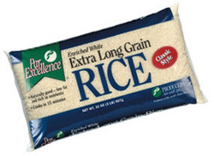
Grams and Kilograms
This bag of rice
weighs 1 kilogram
Would we use kilograms as a unit to weigh heavy or light things?
It would make sense to use kilograms to weigh…
It would NOT make sense to use kilograms to weigh…

Slide 3
Grams and Kilograms
We know that a paper clip weighs 1 gram.
How many grams do you think this bag of rice weighs?

Slide 4


Grams and Kilograms
Remember, 1 paper clip weighs 1 gram
1,000 paper clips = 1000 grams
1 bag of rice= 1 kilogram
=
There are 1,000 grams in 1 kilogram
Are grams a bigger or smaller unit of measurement than kilograms?

Slide 5
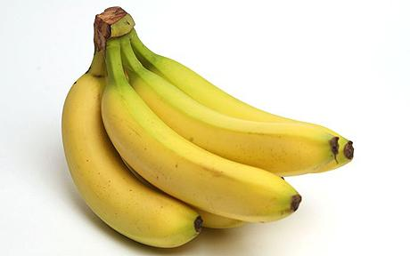
Grams and Kilograms
What unit of measurement (grams or kilograms) would be best to measure the weight of a bunch of bananas?
Kilograms

Slide 6

Grams and Kilograms
What unit of measurement (grams or kilograms) would be best to measure the weight of a feather?
Grams

Slide 7

Grams and Kilograms
What unit of measurement (grams or kilograms) would be best to measure the weight of a pencil?
Grams

Slide 8

Grams and Kilograms
What unit of measurement (grams or kilograms) would be best to measure the weight of a bag of flour?
Kilograms

Slide 9
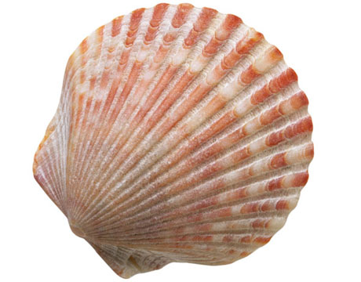
Grams and Kilograms
What unit of measurement (grams or kilograms) would be best to measure the weight of a small seashell?
Grams

Slide 10

Grams and Kilograms
What unit of measurement (grams or kilograms) would be best to measure the weight of a packed suitcase?
Kilograms

Slide 11


Grams and Kilograms
Which weight is lighter?: 60 grams or 3 kilograms?
  60 grams is lighter!
Which weight is heavier: 1,000 grams or 1 kilogram?
  Trick question – they’re the same weight!
Which weight is lighter: 700 grams or 1 kilogram?
  700 grams is lighter!
Which weight is heavier: 90 grams or 50 kilograms?
  50 kilograms is heavier!
Remember, 1 gram feels like 1 paperclip
Remember, 1 kilogram feels like 1 bag of rice or 1,000 paper clips

Slide 12
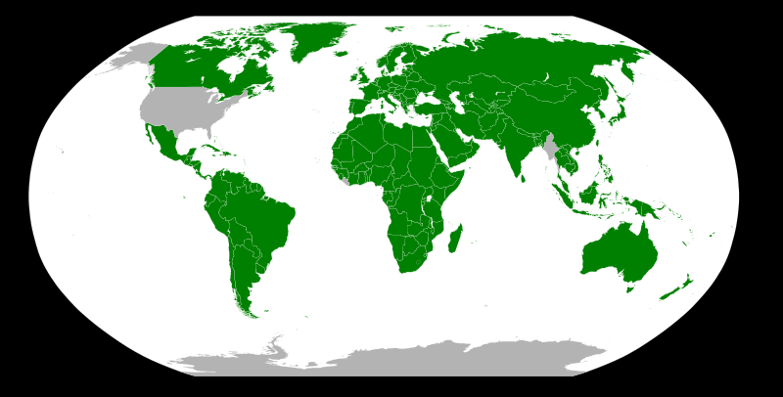
Grams and Kilograms
Grams and Kilograms are Metric units to measure weight.
Most countries in the world (countries in green) use Metric units like grams and kilograms to weigh things.

